Slide 1

BioE 140L Synthetic Biology Lab
TTh 9:30-12:30
F 12-2
Prof: J. Christopher Anderson
Office Hours: Weds 3-4 in EBB Lobby (or by appointment)

Slide 2
Outline for today
What is Synthetic Biology?
What are parts?
The group project
Course content
Grading
First assignment

Slide 3
What is Synthetic Biology?

Slide 4
Synthetic Biology
Adding multi-gene DNAs into well-characterized organisms to understand biological behavior or perform useful functions in diverse areas including therapeutics, biosensors, bioenergy, bioremediation, chemicals, and materials production.
Putting the Engineering back in Genetic Engineering

Slide 5
Science
Engineering
Applied Science
Discovery
Characterization
Theory
Design
Fabrication
Testing
Theory
Understanding how natural systems work
Constructing useful things

Slide 6

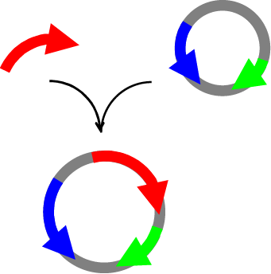
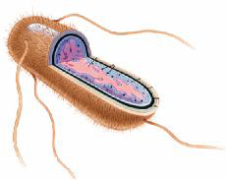
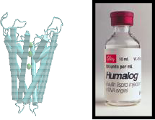
Traditional Biotechnology

Slide 7
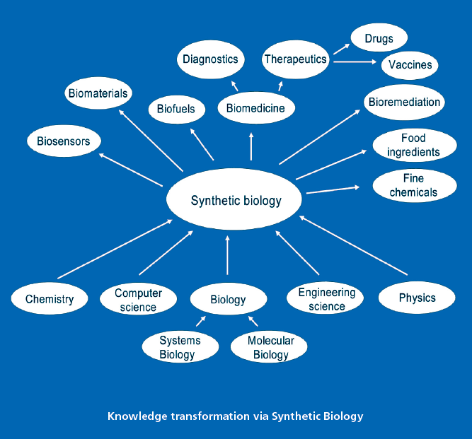
Synthetic Biology Applications
Courtesy: TESSY Leaflet

Slide 8
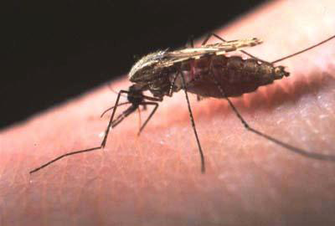
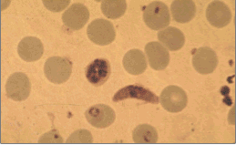
Malaria
Caused by Plasmodium, a single-cell protozoan
Transmitted by Anopheles mosquito
Destroys red blood cells
1.5-2.7 million people die of malaria every year
90% of the victims are children
40% of the world’s population is at risk

Slide 9
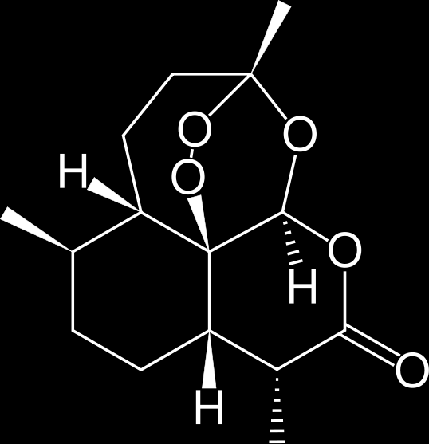
Microbial Synthesis of Artemisinin
100,000
10,000
1000
100
atoB
HMGS
tHMGR
10
1
MK
PMK
MPD
idi
ispA
Isoprenoid (mg/L)
0.1
0.01
ADS
AMO
CPR
0.001
0.0001
2001
2002
2003
2004
2005
2006
Keasling Lab, UC Berkeley

Slide 10

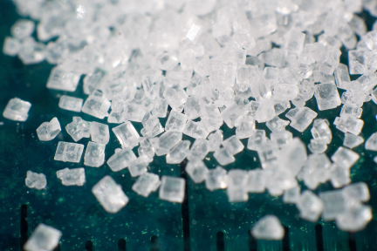

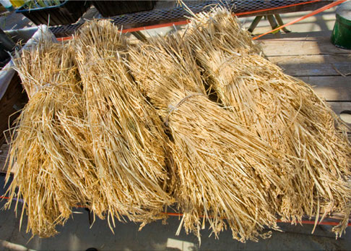
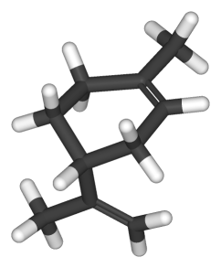
Second Generation Biofuels

Slide 11
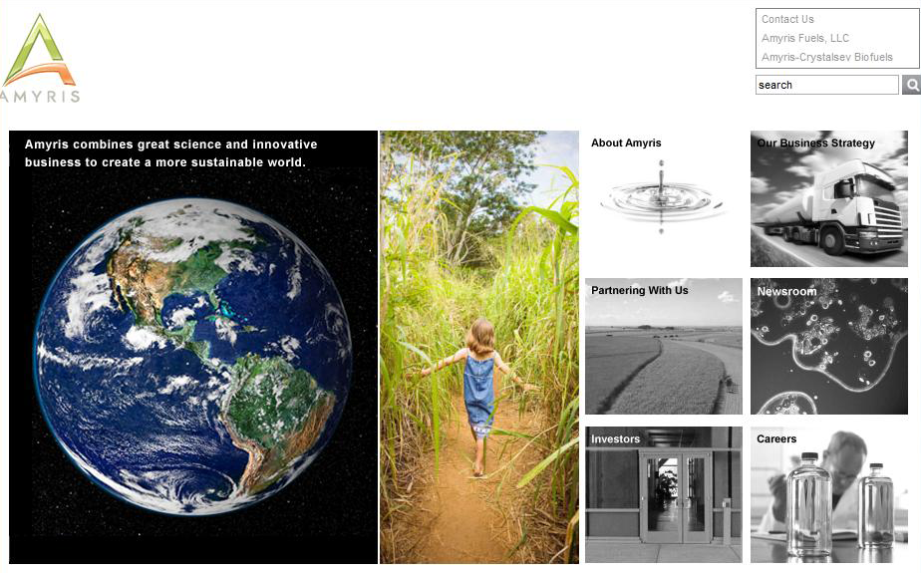
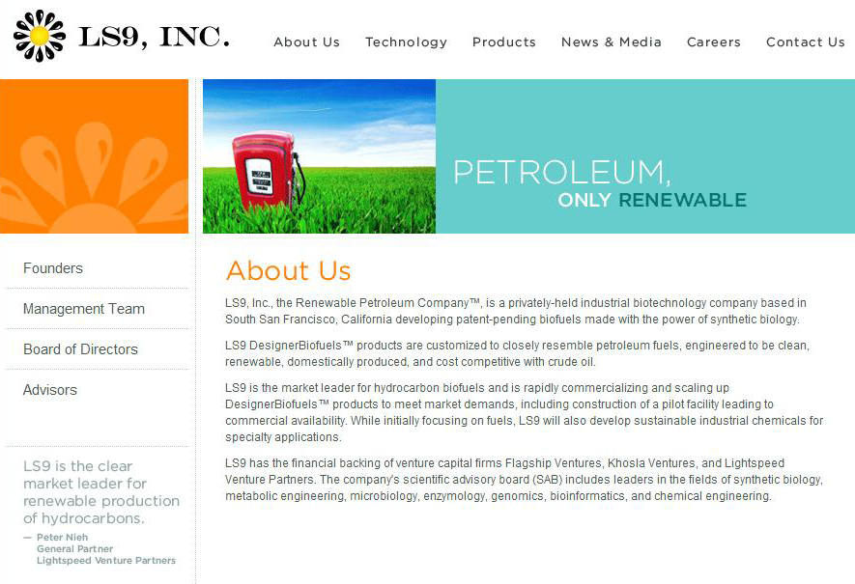

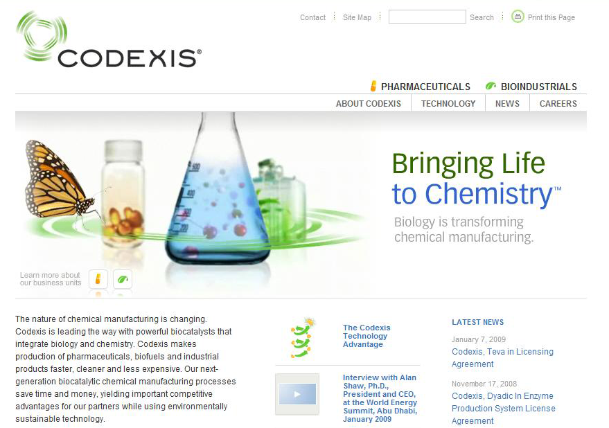

Slide 12
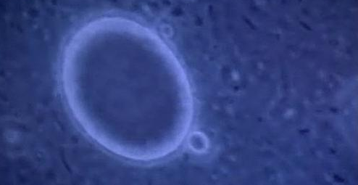
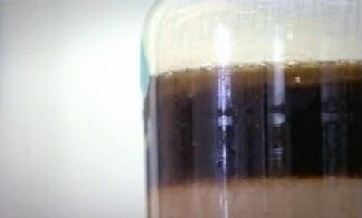
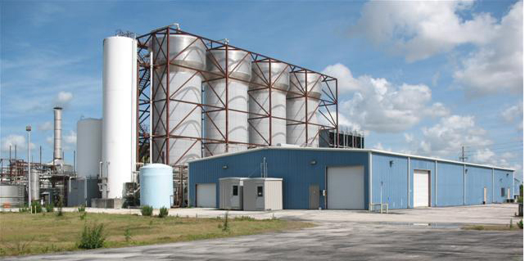

Second Generation Biofuels

Slide 13
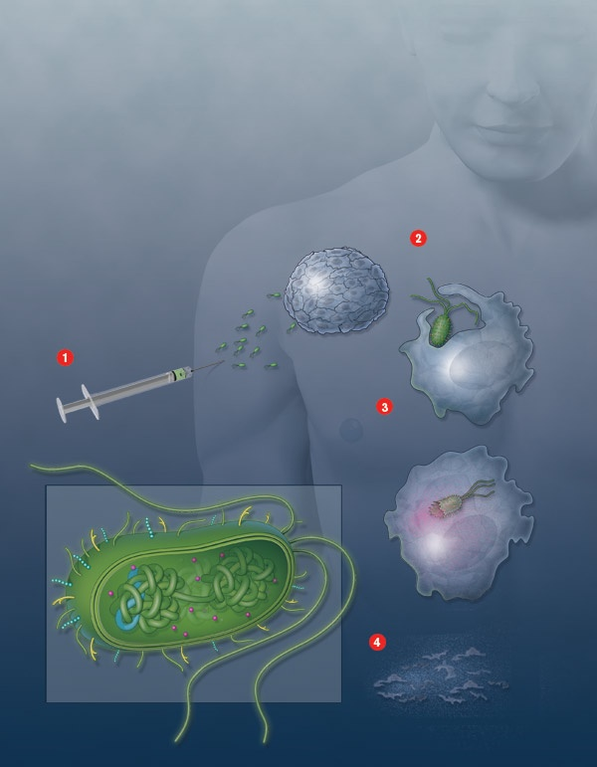
Tumor Killing Bacteria:
A testbed for modular design of biology systems
Tami Tolpa, Technology Review, 2007

Slide 14
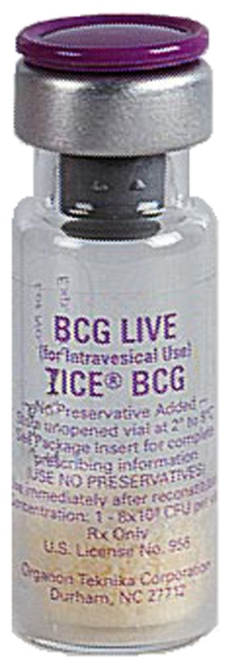
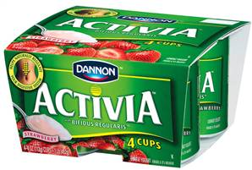
Digestive Disorders
Bladder Cancer

Slide 15

Sustainable Water Desalination

Slide 16
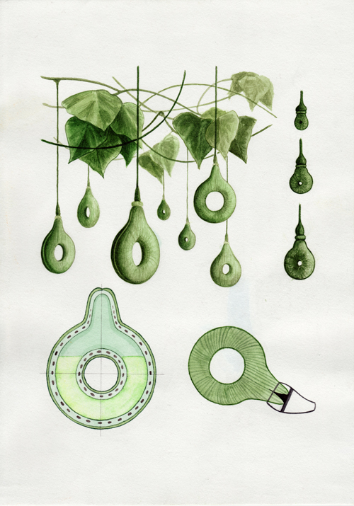
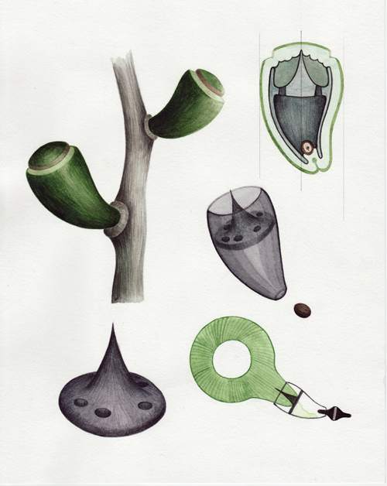
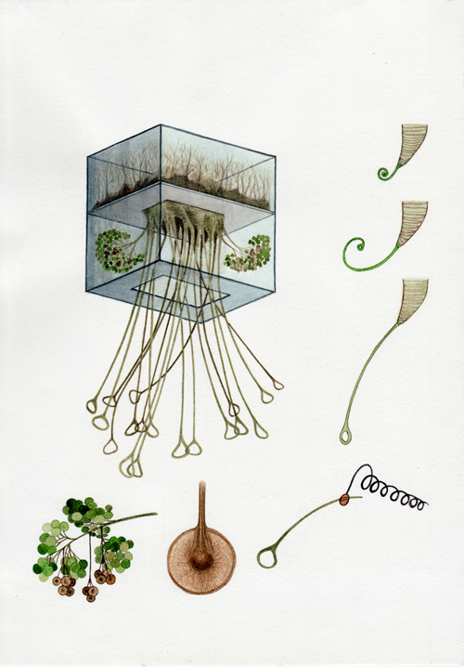
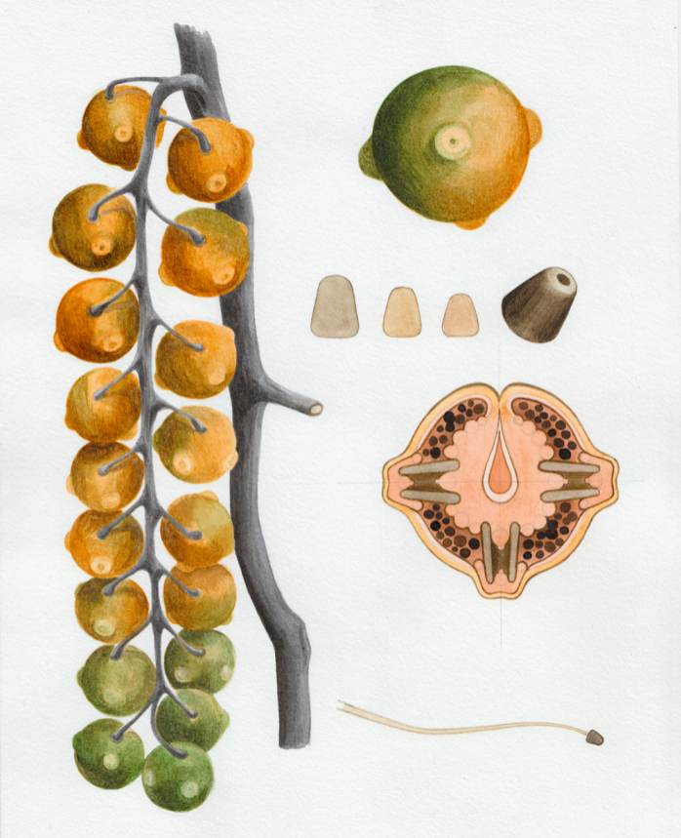
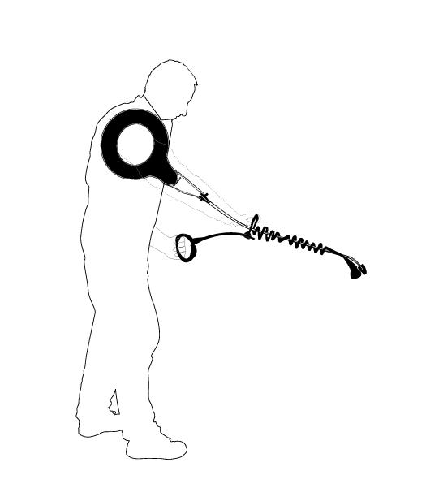
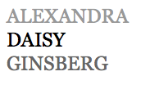
Herbicide Gourd
Connector Fruit
Handle Plant
http://www.daisyginsberg.com
Herbicide Sprayer (Nozzle Fruit)
Herbicide Sprayer, assembled

Slide 17
What is Synthetic Biology?
Characteristics:
Focus on regulation (who, what vs where, when, how much)
Multi-gene circuits or networks
Modular design
Putting the Engineering back in Genetic Engineering
Exploiting new DNA synthesis methods
Employing parts from diverse origins
Exploiting "omics" tools
Unconventional whole-cell technologies

Slide 18
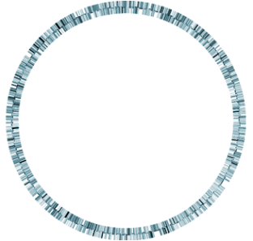
Genetic Hierarchy
Biological Engineering?
Protein Engineering
Promoter Engineering
Synthetic Biology
bases
“parts”
A T
C G
“devices”
genomes
0.5-10Mb
1-20kb
0.1-3kb
1bp
Notes:
Pieces function independently and in combination as observed by in vitro assays.
However, those may or may not be indicative of in vivo behavior.
Confirmation that devices function as expected in an mouse model, and that they function in a mostly independent way. To approach this, we plan on confirming their effect on bacterial clearance from the bloodstream and on tnf-alpha levels in the bloodstream (which is a measure of immune response to lipopolysaccharide and other bacterial components).

Slide 19
What are “parts”?

Slide 20
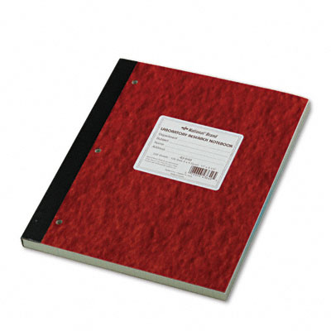
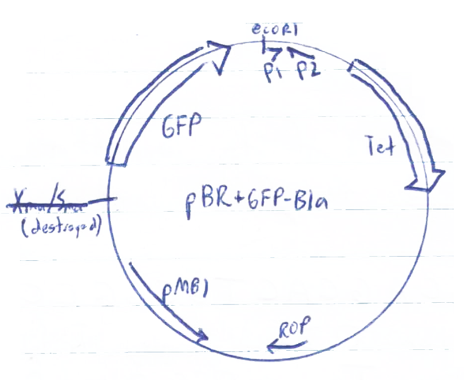
The traditional approach
Feature
Plasmid

Slide 21
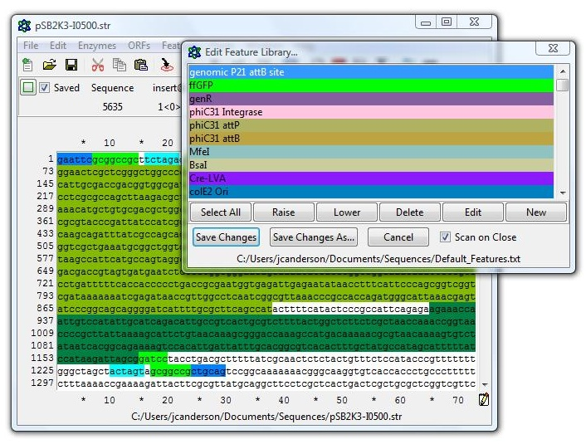
Features in ApE
Feature
Feature

Slide 22
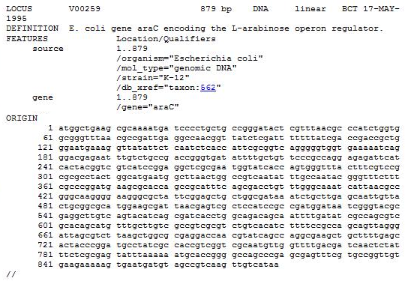
Genbank descriptions
Feature

Slide 23
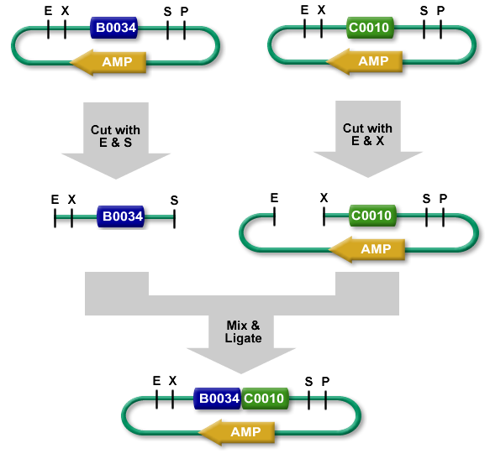
The Biobricks Standard
BioBrick Standard Assembly

Slide 24
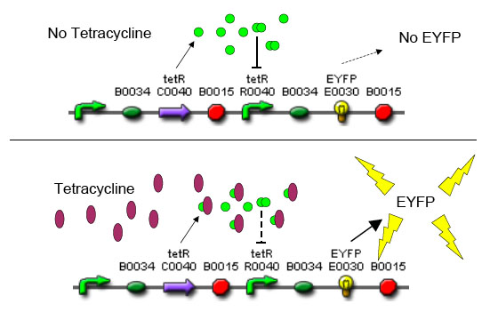
BioBrick Compositions
Basic Part
Composite Part encoding a Device

Slide 25

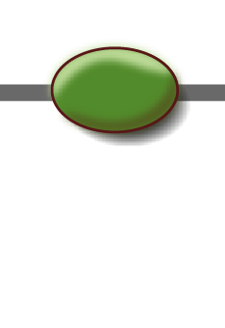


The Registry of Parts
Basic Parts
Promoters
Ribosome Binding Sites
Open Reading Frames
Terminators
Devices
A GFP Producing Device
tetR RBS GFP Ter. Ter.

Slide 26
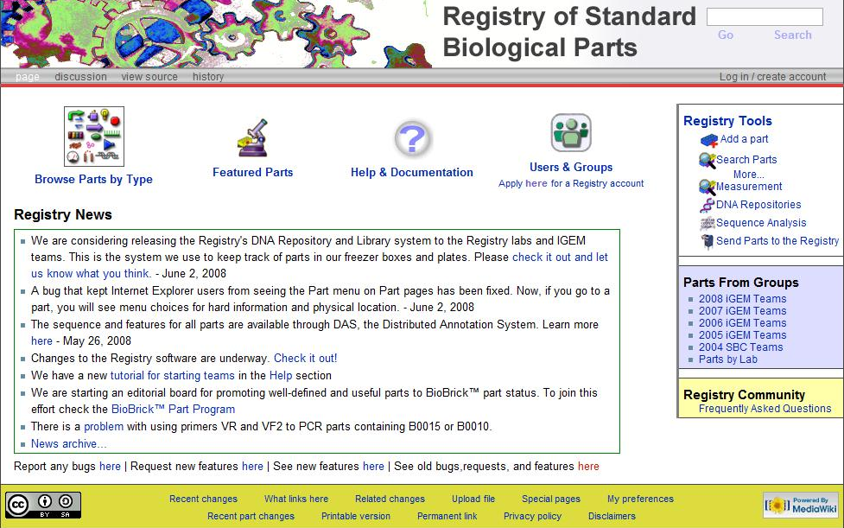

Slide 27
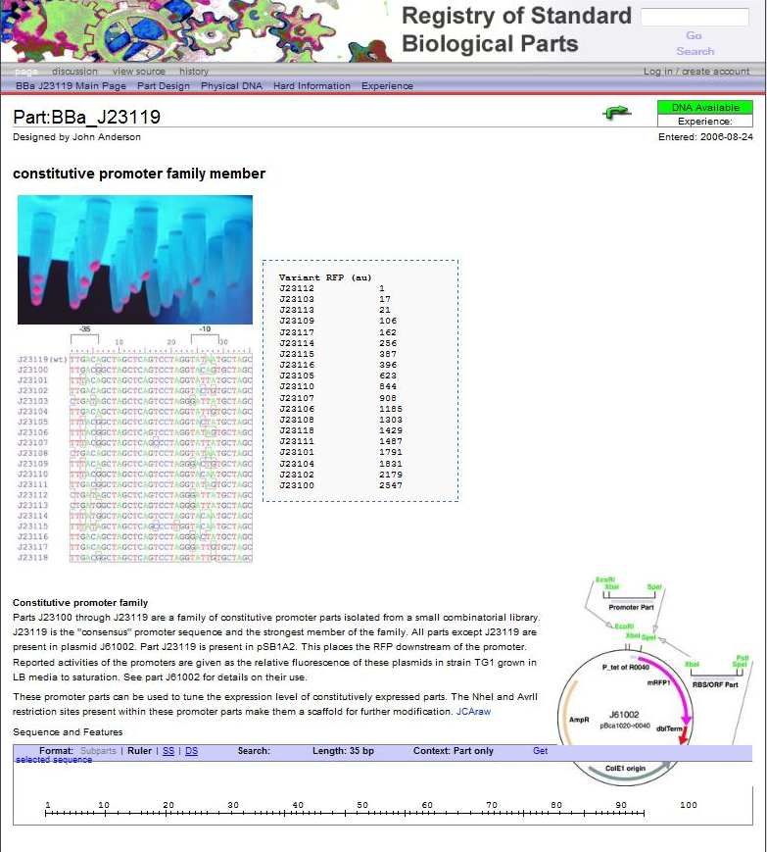

Slide 28
A BglBrick basic part
sca10
{<AP!}
Feature
GATCTggcctgaacgatatttttgaagcgcagaaaattgaatggcatgaataaG
Basic Part

Slide 29
“Standard Biological Parts” are parts that conform to a particular set of rules (a composition standard or Format) defined to guarantee their ability to be physically joined into a contiguous DNA molecule
“BioBrick™ Parts” are parts that conform to the standards put forth by the “Biobrick Foundation,” but often the term is used to describe Parts that obey any assembly protocol
There are now many of these Formats
“BglBricks Parts” are parts that conform to the BglBricks composition Format
“Golden Gate Parts” are another

Slide 30
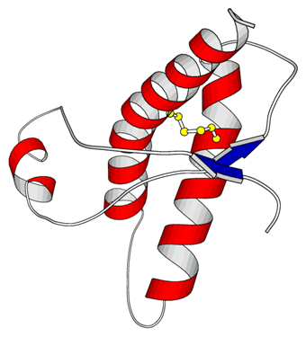
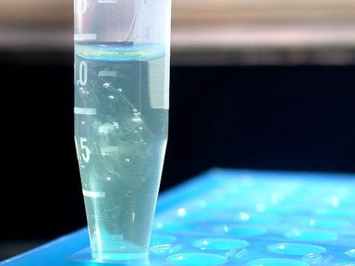

“Features” represent defined DNA sequences encoding primitive elements of biological function such as protein coding sequences, promoter sequences, and origins of replication and their biochemical properties
“Parts” are compositional primitives that obey a Format and usually contain one Feature
atgaaaaacataaatgccgacgacacatacagaataattaataaaattaaagcttgtagaagcaataatgatattaatcaatgcttatctgatatgactaaaatggtacat...

Slide 31
“Devices” are collections of parts that encode a human-defined function
Receiver Device
A “genetic circuit”

Slide 32
“Devices" are collections of parts that encode a human-defined function
atoB
HMGS
tHMGR
MK
PMK
MPD
idi
ispA
ADS
AMO
CPR
Artemisinin Device
A “biosynthesis device”

Slide 33
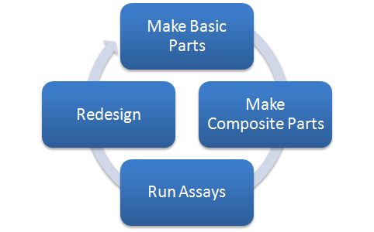
The Synthetic Biology design cycle

Slide 34
Design in Synthetic Biology
Composition Design
What parts is it made from?
Experimental Design
What substructures or variants do you build such that functionality can be measured?
Technical Design
How will you build the DNAs?

Slide 35
The Group Project

Slide 36
Course Content

Slide 37
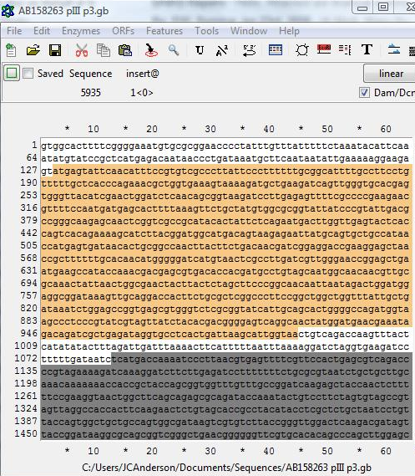
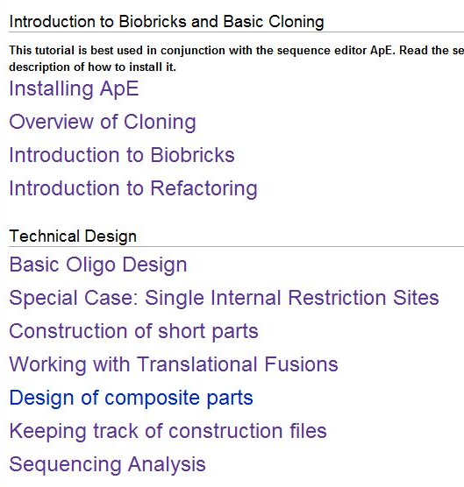
First few weeks: Tutorials

Slide 38
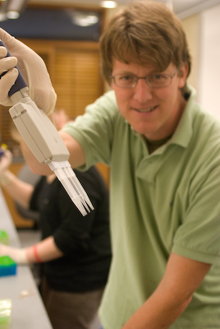
Your group project
Tues and Thurs, and some Fridays: bench work!
Most Fridays: Lectures on advanced cloning methods, applied molecular biology, directed evolution, and experimental analysis

Slide 39

Begin designing your project proposal

Slide 40
Finish writing your proposal
Take the final exam
Have a great summer!
Participate in iGEM ?

Slide 41

Program
Statistics from 2010:
>1,200 participants
130 teams from 21 countries
800,000 google hits for “iGEM” on 1/9/09
“It’s 140L on steroids!”
Notes:
41

Slide 42
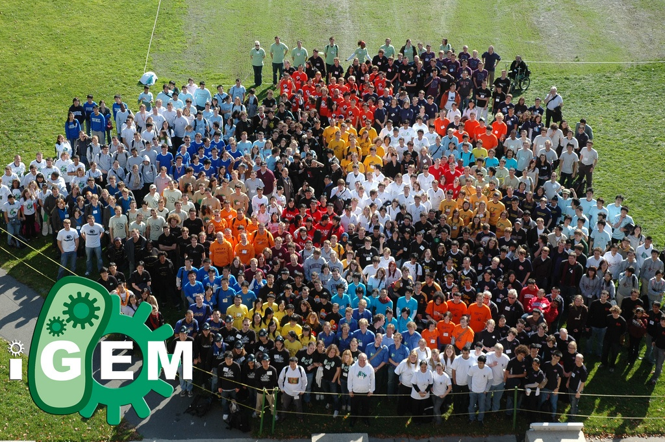
iGEM Program
iGEM 2008 - photo courtesy of iGEM and David Appleyard
Notes:
42

Slide 43
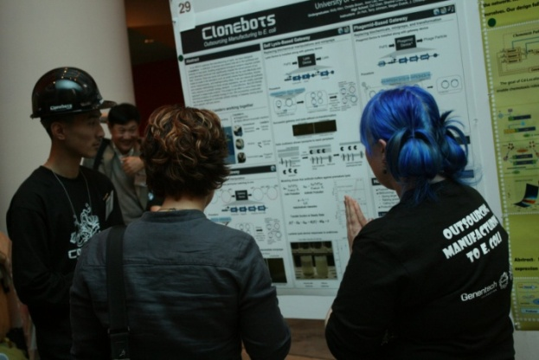

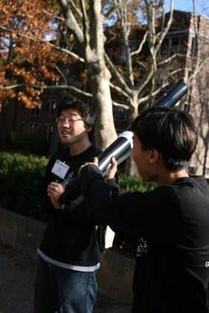

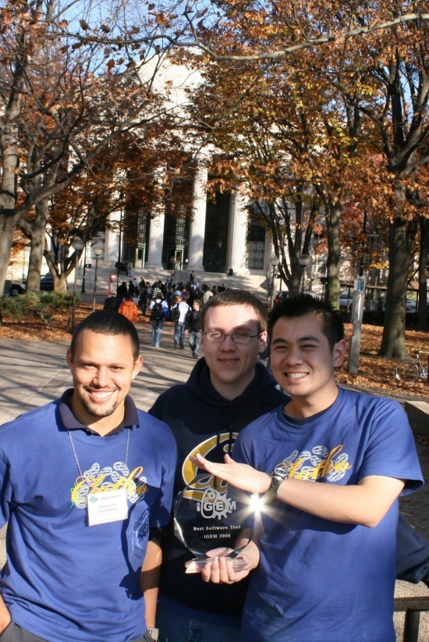
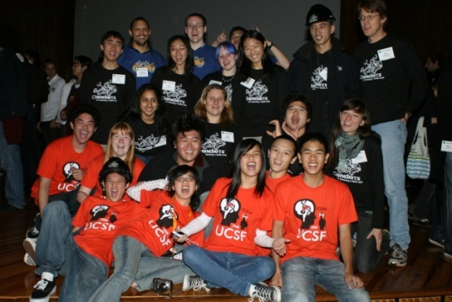

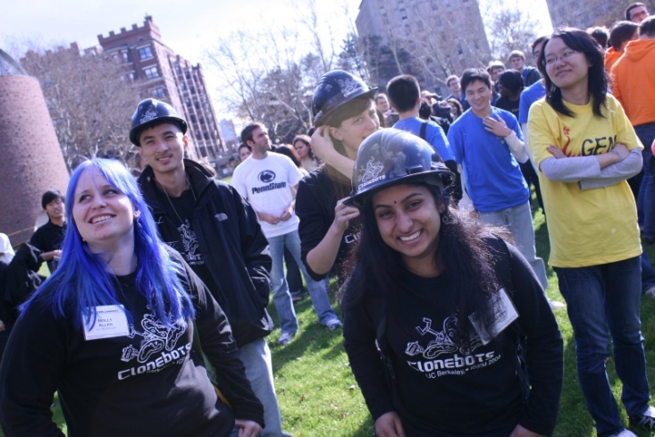

iGEM Program
Notes:
43

Slide 44
Grading
Midterm Exam: Take-home, covers DNA manipulation and analysis
Final Exam: Written exam, covers experimental design, analysis, and interpretation
*Midterm and Project Proposal are due on time. The penalty for late submission is 1 pt per hour unless an alternate due date is arranged at least 5 days in advance
** Tutorials are due on time. You will receive 0 points for late submissions
Proposal: You propose a project, write up a proposal including technical details

Slide 45
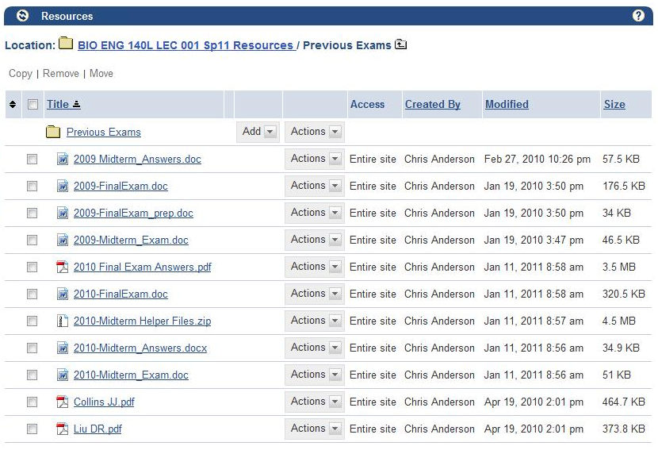
Typical results
Final Grade Distribution:
4A, 3 A-, 2 B+, 5 B-, 1 C-

Slide 46
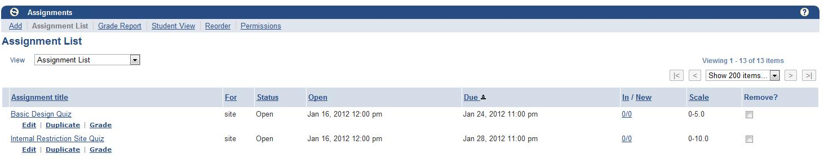
First Assignment
First Tutorial Quiz due Jan 31!
Try to download ApE and read through first sections before Tuesday
Tues work during class time
Bring your laptop if you have one!!

